Slide 1
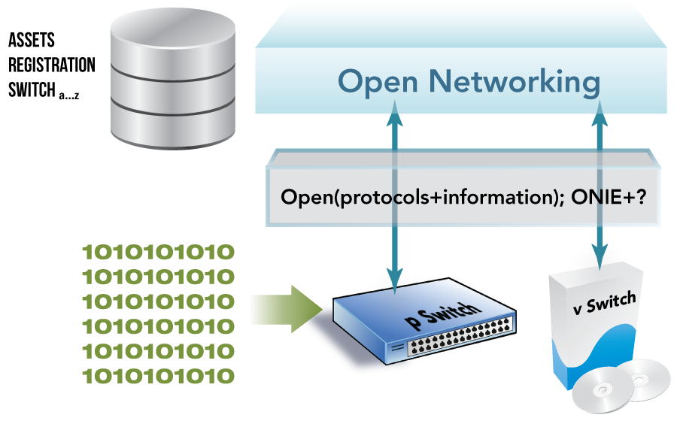
Six Steps To A Common Open Networking Ecosystem
Common Auto(discovery+provisioning+asset registration)

Slide 2
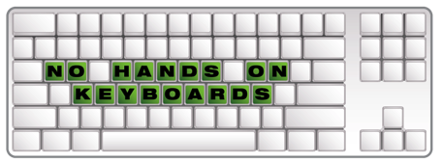
Six Steps To A Common Open Networking Ecosystem
Common DevOps/NetOps
configuration + change management tools

Slide 3
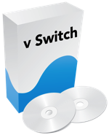
Six Steps To A Common Open Networking Ecosystem
Common
control mechanism for (p+v)(Switches+Routers)

Slide 4
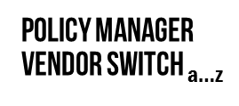
Six Steps To A Common Open Networking Ecosystem
Common baseline policy – enforced by common controller environment

Slide 5
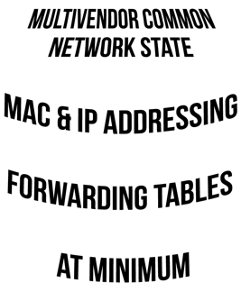
Six Steps To A Common Open Networking Ecosystem
Common
state management: (VENDORa…z(p+v)switch)

Slide 6
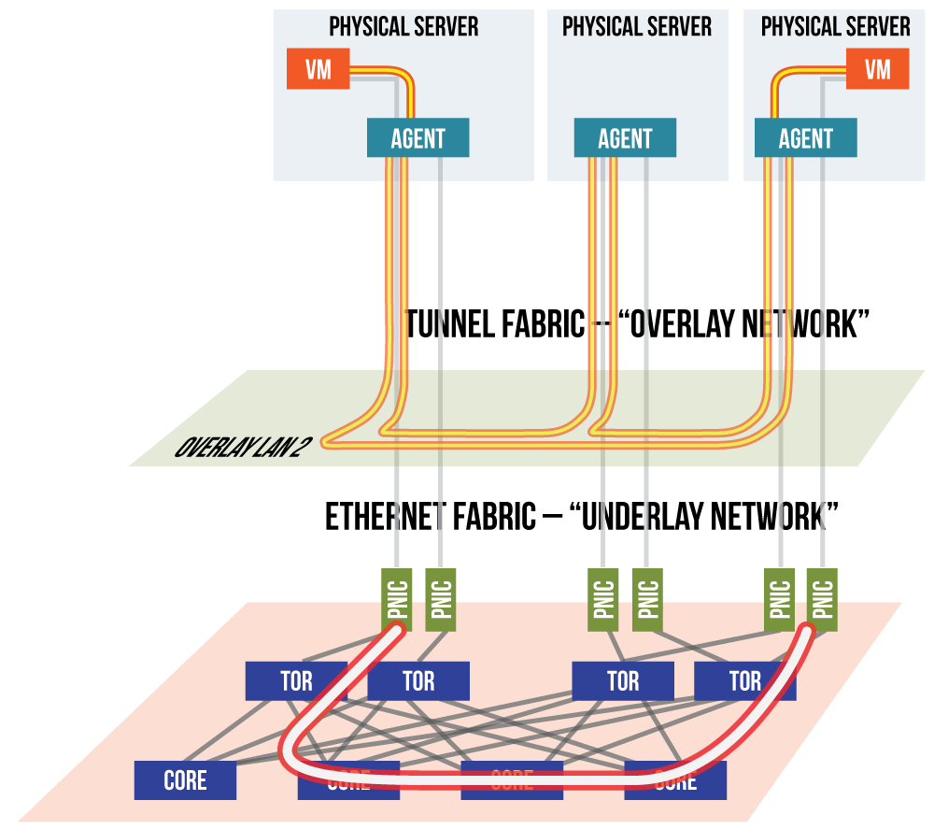
Six Steps To A Common Open Networking Ecosystem
Common
Integrated Monitoring

